Slide 1
React.js
Course: CSC 436 Web Applications Instructor: Paul Duszak
Quarter: Fall 2022

Slide 2
API Authentication

Slide 3
Blog API Endpoints
Some of the below routes require authorization in order to perform the requested operation; next, we’ll look at standard authorization mechanisms utilized by REST APIs
Operation | API Endpoint | HTTP Method | Protected?
Create a user | /api/users | POST | No
Get all users | /api/users | GET | No
Get a specific user | /api/users/:userId | GET | No
Update a user | /api/users/:userId | PUT/PATCH | Yes
Delete a user | /api/users/:userId | DELETE | Yes
Create a post | /api/posts | POST | Yes
Get all posts | /api/posts | GET | No
Get a specific post | /api/posts/:postId | GET | No
Update a post | /api/posts/:postId | PUT/PATCH | Yes
Delete a post | /api/posts/:postId | DELETE | Yes
User signin | /api/auth/signin | POST | No

Slide 4
HTTP and Authentication
HTTP is stateless, as such we need some mechanism to authorize each request we make to the backend
Session-based and token-based authentication are two methods which can be utilized to authorize calls to a backend server
Most REST APIs you encounter will utilize token-based authentication

Slide 5
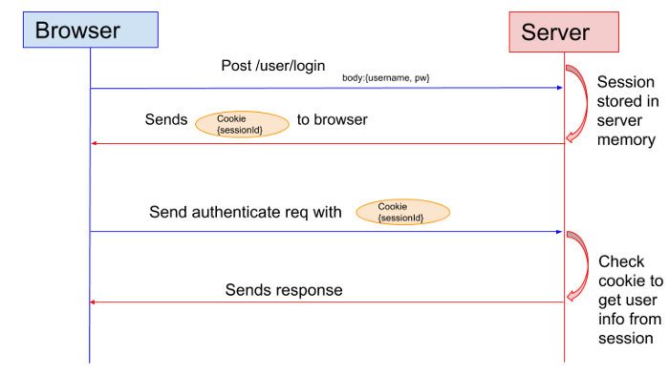
Session based authentication
Server will create a session for the user upon login
A session ID is stored in a cookie on the user’s browser
While the user stays logged in, the cookie is sent with every subsequent request
The server can compare the session id stored on the cookie against the session information stored in server memory to verify user’s identity and retrieve their information

Slide 6
JSON Web Token (JWT)
JSON Web Token (JWT) is an open standard (RFC 7519) that defines a compact and self-contained way for securely transmitting information between parties as a JSON object
Signed tokens can verify the integrity of the claims contained within it, but do not hide the claims themselves

Slide 7
JWT Structure
In its compact form, JSON Web Tokens consist of three parts separated by dots (.), which are:
Header
Payload
Signature
Therefore, a JWT typically looks like the following: xxxxx.yyyyy.zzzzz

Slide 8
JWT Header
The header typically consists of two parts: the type of the token, which is JWT, and the signing algorithm being used, such as HMAC SHA256 or RSA.
{
"alg": "HS256",
"typ": "JWT"
}
Then, this JSON is Base64Url encoded to form the first part of the JWT.

Slide 9
JWT Payload
The second part of the token is the payload, which contains the claims. Claims are statements about an entity (typically, the user) and additional data. There are three types of claims: registered, public, and private claims.
Registered claims: These are a set of predefined claims which are not mandatory but recommended, to provide a set of useful, interoperable claims. Some of them are: iss (issuer), exp (expiration time), sub (subject), aud (audience), and others.
Private claims: These are the custom claims created to share information between parties that agree on using them and are neither registered or public claims.
{
"sub": "1234567890",
"name": "John Doe",
"admin": true
}
Then, this JSON is Base64Url encoded to form the first part of the JWT.

Slide 10
JWT Signature
To create the signature part you have to take the encoded header, the encoded payload, a secret, the algorithm specified in the header, and sign that.
For example if you want to use the HMAC SHA256 algorithm, the signature will be created in the following way:
HMACSHA256(
base64UrlEncode(header) + "." +
base64UrlEncode(payload),
secret)
The signature is used to verify the message wasn't changed along the way, and, in the case of tokens signed with a private key, it can also verify that the sender of the JWT is who it says it is.

Slide 11
Sending a JWT in an API request
For HTTP requests that are made following a successful sign-in, especially requests for API endpoints that are protected and have restricted access, the client-side must attach a JWT token to the request
The JSON Web Token must be included in the request Authorization header as a Bearer:
Authorization: Bearer <JSON Web Token>
When the server receives a request for a protected API endpoint, it checks the Authorization header of the request for a valid JWT, then verifies the signature to identify the sender and ensures the request data was not corrupted. If the token is valid, the requesting client is given access to the associated operation or resource; otherwise, an authorization error is returned.

Slide 12
bCrypt & jsonwebtoken
https://www.npmjs.com/package/bcrypt
https://www.npmjs.com/package/jsonwebtoken

Slide 13
React Performance Optimizations

Slide 14
Optimizing rendering using React.memo
If a component’s props have not changed, re-rendering the component yields no benefit and degrades performance. React.memo memorizes the last rendered result and if props did not change, it will skip rendering the component.
In order to memorize a component, we need to wrap it’s export in a React.memo call:
const SomeComponent = () => ...
export default React.memo(SomeComponent)
By default, React.memo will only shallowly compare the props object. If we want to do a special comparison, we can pass a function as a second argument to React.memo:
export default React.memo(SomeComponent, (prevProps, nextProps) => {
// compare props and return true if the props are equal and we should not update
})

Slide 15
Optimizing rendering using React.memo
If a component’s props have not changed, re-rendering the component yields no benefit and degrades performance. React.memo memorizes the last rendered result and if props did not change, it will skip rendering the component.
In order to memorize a component, we need to wrap it’s export in a React.memo call:
const SomeComponent = () => ...
export default React.memo(SomeComponent)
By default, React.memo will only shallowly compare the props object. If we want to do a special comparison, we can pass a function as a second argument to React.memo:
export default React.memo(SomeComponent, (prevProps, nextProps) => {
// compare props and return true if the props are equal and we should not update
})

Slide 16

Examining how the Post Component renders
Let’s examine the Post component to see if it’s unnecessarily re-rendering
Method 1:
Add console.log(“Post rendered”) statement to the function body in Post.js
Open the Dev Tools console and reload the page; I have 2 posts, and I see my console output printed twice, as expected.
Now, perform a login, we will see that “post rendered is printed to the console twice more, despite no change in posts.
Memoizing the Post component would avoid having the posts re-render.

Slide 17
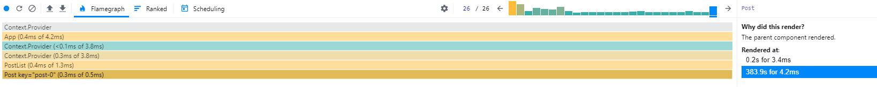
Examining how the Post Component renders
Let’s examine the Post component to see if it’s unnecessarily re-rendering
Method 2:
Install React Dev Tools, navigate to the Profiler
Click the “Reload and Start Profiling” button ->
Perform a login
Click the record button to stop profiling ->
Locate one of the Post components in the resultant flame graph
Examine the right hand “Rendered at” view which indicates the single post was rendered twice, once because the parent component re-rendered (our login)

Slide 18
Memoizing the Post Component
Let’s memorize the Post component to avoid unnecessary re-renders
Post.js:
Remove “export default” from the function declaration
At the bottom of the file, add a new export which calls memo: export default React.memo(Post)
3. Re-test logging in now, we should not see Post re-render after logging in
It is not necessary to memoize every single component, but being aware of how to do it is helpful in the event you encounter obvious performance bottlenecks caused by a component or multiple components frequently re-rendering

Slide 19
What is Lazy Loading?
Lazy loading (also called on-demand loading) is an optimization technique for the online content.
Instead of loading the entire web page and rendering it to the user in one go as in bulk loading, the concept of lazy loading assists in loading only the required section and delays the remaining, until it is needed by the user.
For example, if our blog has a member area, we only need to load it after the user has logged in. Doing this will reduce the bundle size for guests who only visit our blog to read blog posts.
To learn about React Suspense, we are going to lazily load the Logout component in our blog app.

Slide 20
Lazy loading logout with React Suspense
React Suspense provides us with React.Lazy to dynamically load content
Given that a user may never login to our application, loading the Logout component on page load is unnecessary. We will utilize React.Lazy to load it dynamically.
App.js:
First, we have to specify a loading indicator, which will be shown when our lazily-loaded component is loading. In our example, we are going to wrap the UserBar component with React Suspense:
<React.Suspense fallback={"Loading..."}>
<UserBar />
</React.Suspense>
Userbar.js:
We can now remove the dynamic import of Logout in Userbar with a static import which only gets called when React.lazy triggers it, which means it will only be imported when the component is needed:
const Logout = React.lazy(() => import('./Logout'))

Slide 21
Express Introduction

Slide 22
Express.js
Express.js or simply Express is a Node.js web application framework that provides a strong set of features for web applications. It's free, open source, fast, un-opinionated, and is comprised of a simple web framework that's designed for building web applications and APIs
A few of Express’s commonly used features are:
Configuration
Middleware
Views and templates
Routing
Session
Security

Slide 23
Node.js
Node is an open-source program that is built on a JavaScript runtime engine (Chrome's V8) and consists of JavaScript libraries that are implemented in the form of modules. The cross-platform server environment is lightweight and efficient because it uses an event-driven, non-blocking I/O model
Fast code execution: Chrome's V8 engine makes the Node library extremely fast at code execution as V8 compiles JavaScript into native machine code
Single-threaded operation: Node can handle concurrent tasks because its architecture is built to use the single-threaded event loop model
Asynchronous and event-driven I/O: Programs in Node do not run until an event occurs.
Easy scalability: Node applications are relatively easy to scale horizontally as well as vertically

Slide 24
Express Generator
We will create a backend server for our Blog application using Express
Our Express server will replace our mock json-server API
We will use express-generator to generate a boilerplate Express application we can then modify
npm install -g express-generator
express --no-view blog-server
cd blog-server
npm install

Slide 25
Getting started with Express
Creating an Express application requires the following steps:
Importing the Express module
Creating the Express application
Defining route(s)
Configuring the Express application to listen
// load express module
var express = require('express');
//Create express app
var app = express();
// route definition
app.get('/', function (req, res) {
res.send('Hello World');
});
// Start server
app.listen(4000, function () {
console.log('App listening at Port 4000..');
});

Slide 26
Basic Routing
Routing refers to determining how an application responds to a client request to a particular endpoint, which is a URI (or path) and a specific HTTP request method (GET, POST, and so on).
Each route can have one or more handler functions, which are executed when the route is matched.
Route definition takes the following structure:
app.METHOD(PATH, HANDLER)
Where:
app is an instance of express.
METHOD is an HTTP request method, in lowercase.
PATH is a path on the server.
HANDLER is the function executed when the route is matched.

Slide 27
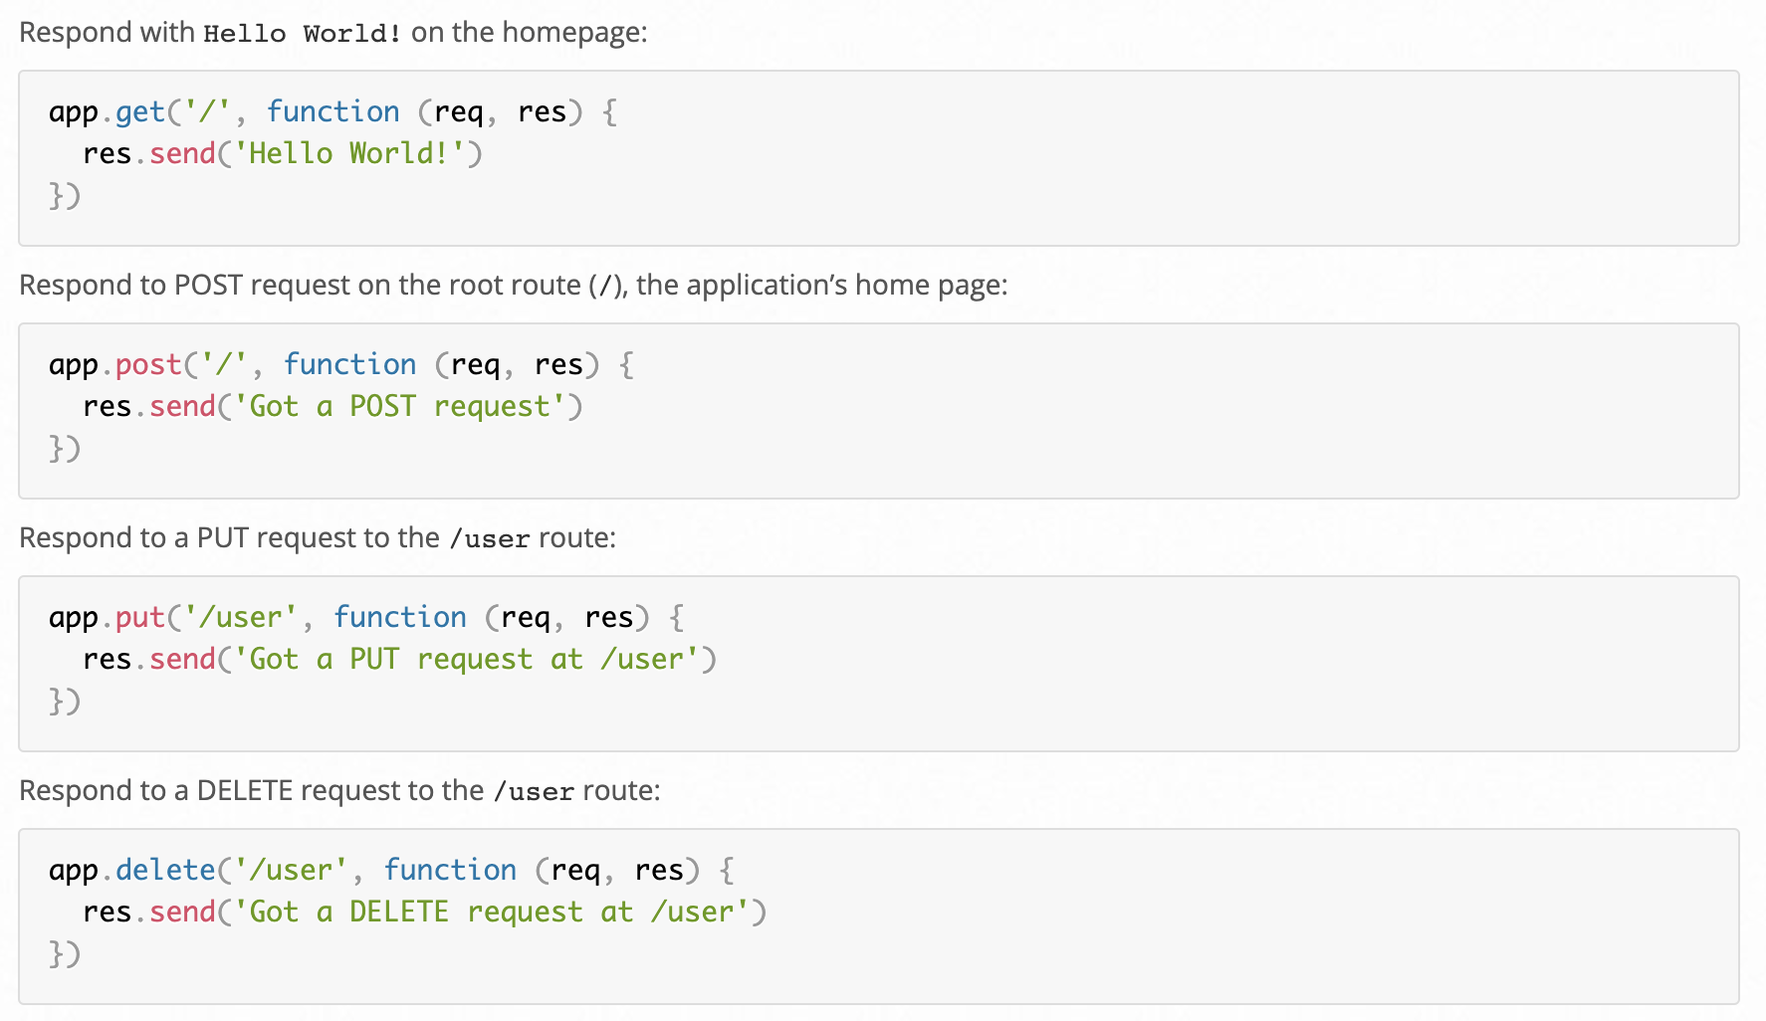
Simple Routes
Below are examples of various simple route configurations and an explanation of their function

Slide 28
Route Parameters
Route parameters are named URL segments that are used to capture the values specified at their position in the URL. The captured values are populated in the req.params object, with the name of the route parameter specified in the path as their respective keys.
Route path: /users/:userId/books/:bookId
Request URL: http://localhost:3000/users/34/books/8989
req.params: { "userId": "34", "bookId": "8989" }
app.get('/users/:userId/books/:bookId', function (req, res) {
res.send(req.params)
})
Hyphen (-) and the dot (.) are interpreted literally, they can be used along with route parameters for useful purposes:
Route path: /flights/:from-:to
Request URL: http://localhost:3000/flights/LAX-SFO
req.params: { "from": "LAX", "to": "SFO" }
Route path: /plantae/:genus.:species
Request URL: http://localhost:3000/plantae/Prunus.persica
req.params: { "genus": "Prunus", "species": "persica" }

Slide 29
Route Parameters
Route parameters are named URL segments that are used to capture the values specified at their position in the URL. The captured values are populated in the req.params object, with the name of the route parameter specified in the path as their respective keys.
Route path: /users/:userId/books/:bookId
Request URL: http://localhost:3000/users/34/books/8989
req.params: { "userId": "34", "bookId": "8989" }
app.get('/users/:userId/books/:bookId', function (req, res) {
res.send(req.params)
})
Hyphen (-) and the dot (.) are interpreted literally, they can be used along with route parameters for useful purposes:
Route path: /flights/:from-:to
Request URL: http://localhost:3000/flights/LAX-SFO
req.params: { "from": "LAX", "to": "SFO" }
Route path: /plantae/:genus.:species
Request URL: http://localhost:3000/plantae/Prunus.persica
req.params: { "genus": "Prunus", "species": "persica" }

